Slide 1
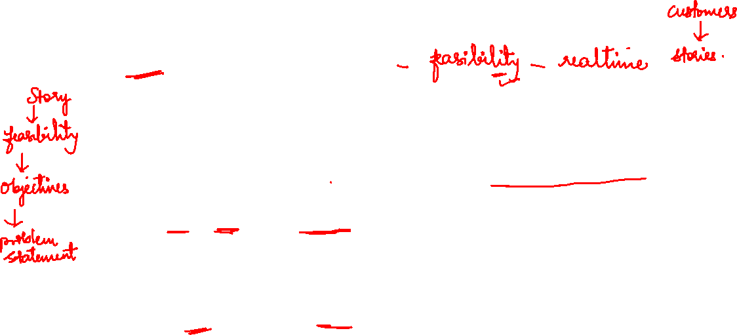
Project selection
• Project selection is the process of evaluating proposed projects or groups of projects, and then choosing to implement some set of them so that the objectives of the parent organization will be achieved.
• “modelling the problem”

Slide 2
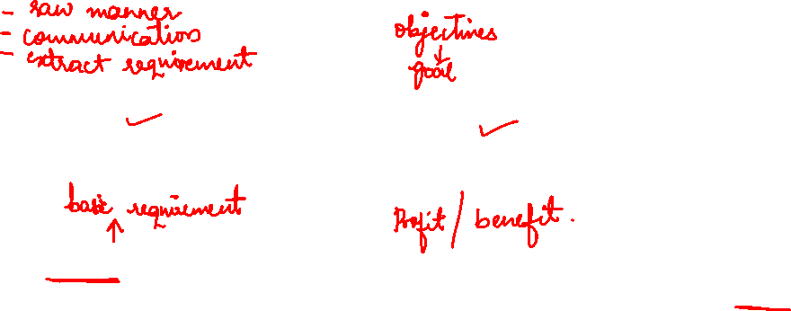
Project Selection Model Criteria
Realism
Capability
Flexibility
Ease of use
Cost
Easy computerization

Slide 3
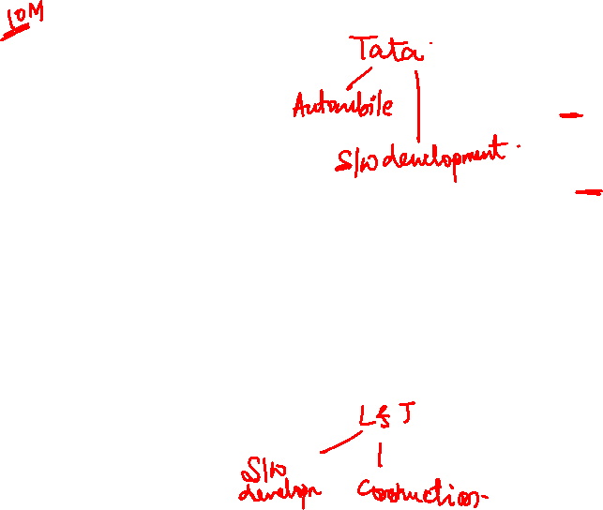
Project portfolio process Symptoms of a misaligned portfolio included:
• Many more projects than management expected.
• Inconsistent determination of benefits.
• Competing projects
• “Interesting” projects that don’t contribute to the strategy.
• Projects whose costs exceed their benefits.
• Projects with much higher risks than others in the portfolio.
• Lack of tracking against the plan, at least quarterly.

Slide 4


Nature of project selection models
Many of the models use financial metrics such as profits and/or cash flow to measure the “correctness” of a managerial decision. Project selection decisions are no exception, being based primarily on the degree to which the financial goals of the organization are met.

Slide 5
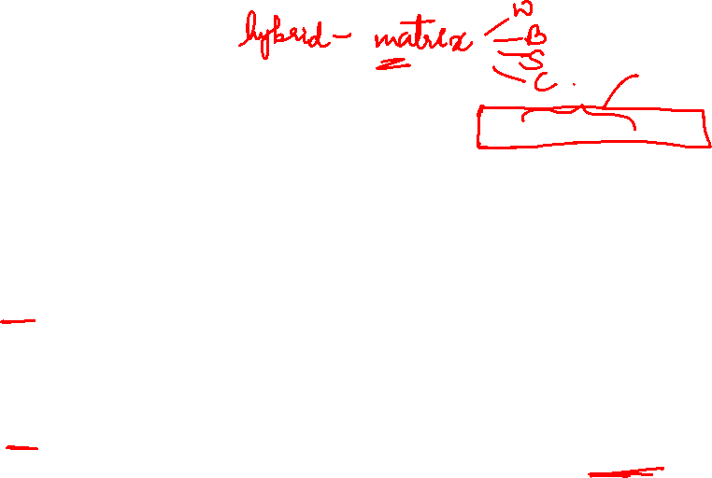
Types
There are two basic types of project selection models, numeric and nonnumeric. Both are widely used. Many organizations use both at the same time, or they use models that are combinations of the two.
Nonnumeric models, as the name implies, do not use numbers as inputs.
Numeric models do, but the criteria being measured may be either objective or subjective. It is important to remember that the qualities of a project may be represented by numbers, and that subjective measures are not necessarily less useful or reliable than objective measures.

Slide 6

Models
Models do not make decisions—people do. The manager, not the model, bears responsibility for the decision. The manager may “delegate” the task of making the decision to a model, but the responsibility cannot be abdicated.
All models, however sophisticated, are only partial representations of the reality they are meant to reflect. Reality is far too complex for us to capture more than a small fraction of it in any model. Therefore, no model can yield an optimal decision except within its own, possibly inadequate, framework.

Slide 7
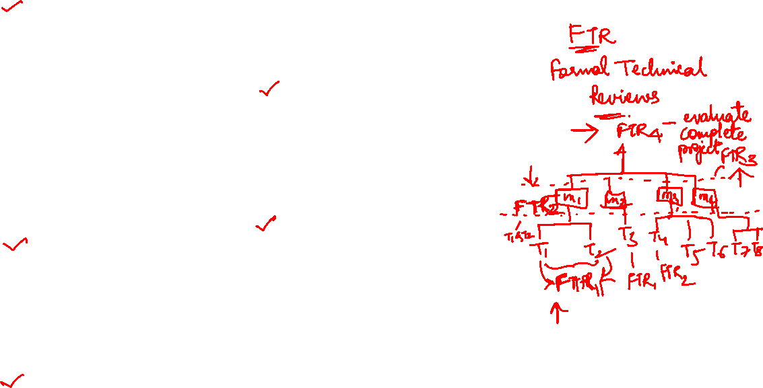

Slide 8

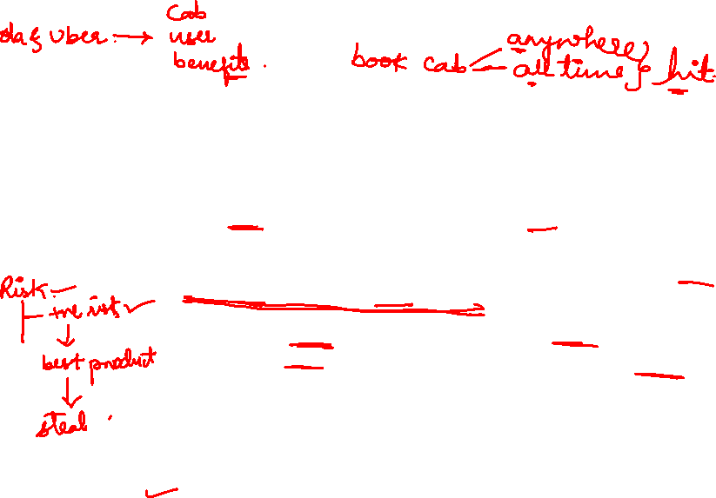
Non-Numeric models
The Sacred Cow-the project is suggested by a senior and powerful official in the organization.
Often the project is initiated with a simple comment such as, “If you have a chance, why don’t you look into…,” and there follows an undeveloped idea for a new product, for the development of a new market, for the design and adoption of a global data base and information system, or for some other project requiring an investment of the fi rm’s resources.
The immediate result of this bland statement is the creation of a “project” to investigate whatever the boss has suggested.
The project is “sacred” in the sense that it will be maintained until successfully concluded, or until the boss, personally, recognizes the idea as a failure and terminates it.

Slide 9

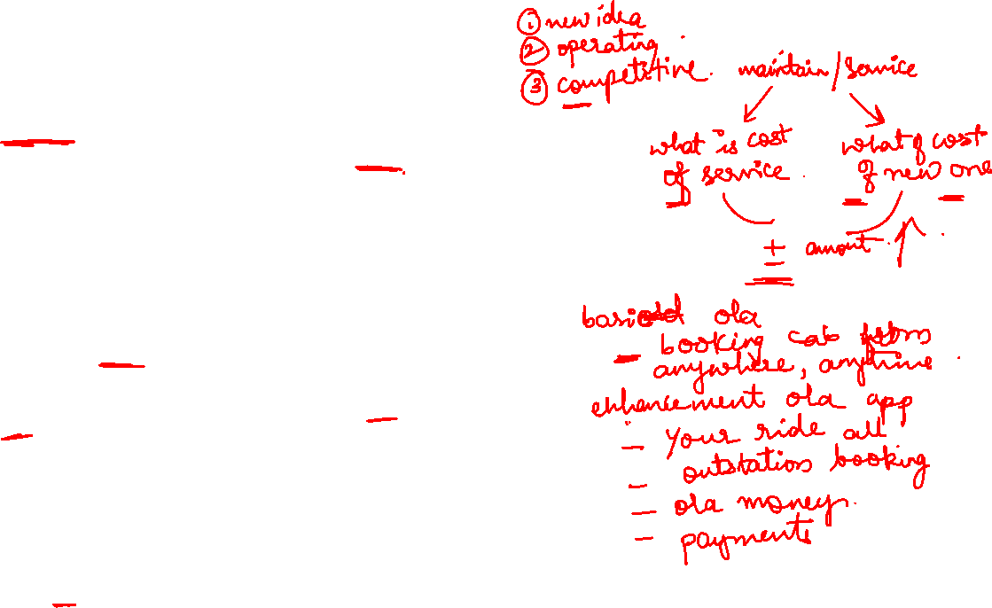
The Operating Necessity If a flood is threatening the plant, a project to build a protective dike does not require much formal evaluation, which is an example of this scenario.
Example -XYZ Steel Corporation has used this criterion (and the following criterion also) in evaluating potential projects. If the project is required in order to keep the system operating, the primary question becomes: Is the system worth saving at the estimated cost of the project? If the answer is yes, project costs will be examined to make sure they are kept as low as is consistent with project success, but the project will be funded.
The Competitive Necessity Using this criterion, XYZ Steel undertook a major plant rebuilding project in the late 1960s in its steel-bar-manufacturing facilities near Chicago.
It had become apparent to XYZ’s management that the company’s bar mill needed modernization if the firm was to maintain its competitive position in the Chicago market area. Although the planning process for the project was quite sophisticated, the decision to undertake the project was based on a desire to maintain the company’s competitive position in that market.
Example education campus enhancements.

Slide 10
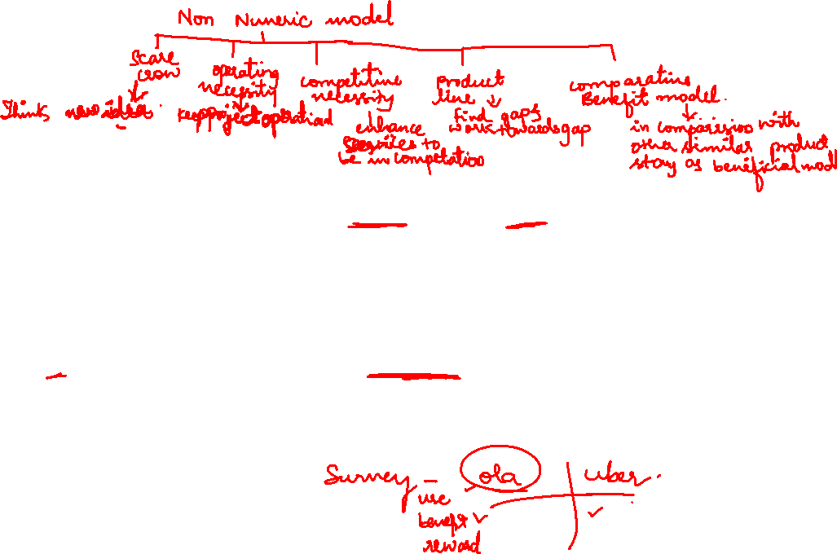
The Product Line Extension In this case, a project to develop and distribute new products would be judged on the degree to which it fits the firm’s existing product line, fills a gap, strengthens a weak link, or extends the line in a new, desirable direction. Sometimes careful calculations of profitability are not required. Decision makers can act on their beliefs about what will be the likely impact on the total system performance if the new product is added to the line.
Comparative Benefit Model For this situation, assume that an organization has many projects to consider, perhaps several dozen. Senior management would like to select a subset of the projects that would most benefit the fi rm, but the projects do not seem to be easily comparable. For example, some projects concern potential new products, some require the conduct of a research and development project for a government agency, some concern changes in production methods, others concern computerization of certain records, and still others cover a variety of subjects not easily categorized (e.g., a proposal to create a day care center for employees with small children). The organization has no formal method of selecting projects, but members of the Selection Committee think that some projects will benefit the firm more than others, even if they have no precise way to defi ne or measure “benefit.”

Slide 11
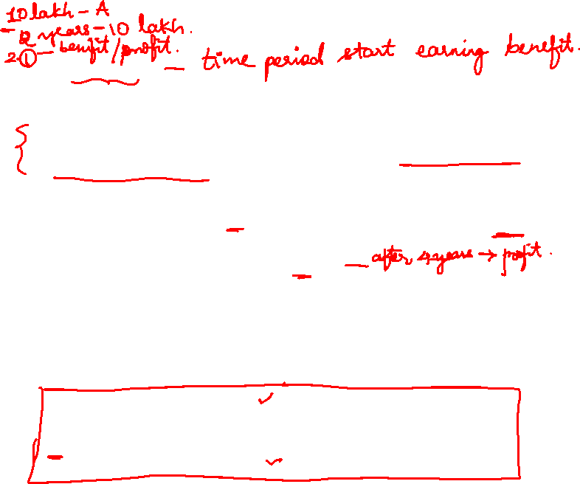
Numeric Models: Profit/Profitability
Payback Period
The payback period for a project is the initial fixed investment in the project divided by the estimated annual net cash inflows from the project. The ratio of these quantities is the number of years required for the project to repay its initial fixed investment.
For example, assume a project costs $100,000 to implement and has annual net cash inflows of $25,000. Then
Payback period = $100,000/$25,000= 4 years
This method assumes that the cash inflows will persist at least long enough to pay back the investment, and it ignores any cash inflows beyond the payback period. The method also serves as an (inadequate) proxy for risk. The faster the investment is recovered, the less the risk to which the fi rm is exposed.

Slide 12

Discounted Cash Flow Also referred to as the net present value (NPV) method, the discounted cash flow method determines the net present value of all cash flows by discounting them by the required rate of return (also known as the hurdle rate, cutoff rate, and similar terms) as follows:

Slide 13


Slide 14
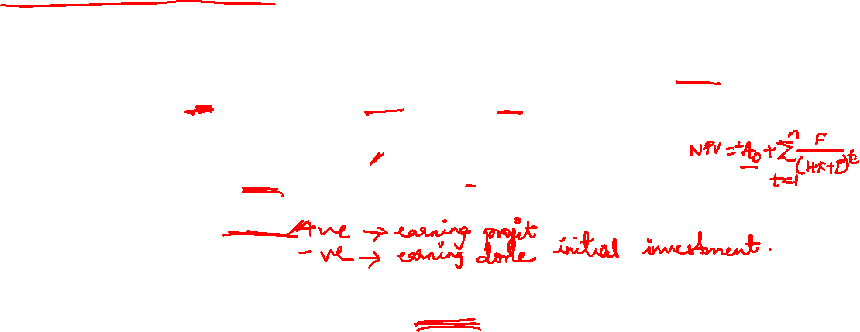

Slide 15

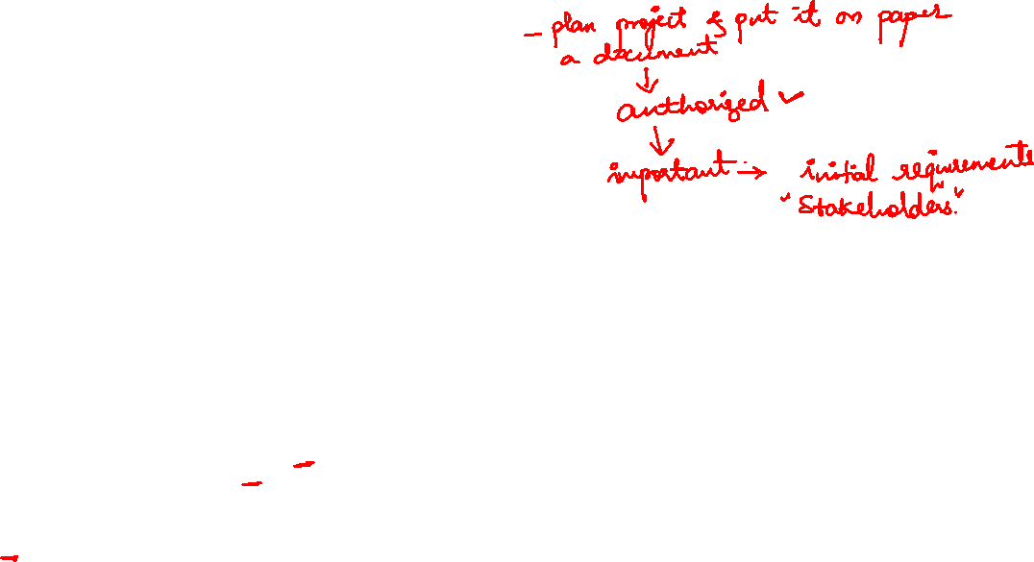
Project charter
Project Charter is the process of developing a document that formally authorizes a project or a phase and documenting initial requirements that satisfy the stakeholder’s needs and expectations.
In multi- phase projects, this process is used to validate or refine the decisions made during the previous iteration of Develop Project Charter.

Slide 16
. It establishes a partnership between the performing organization and the requesting organization (or customer, in the case of external projects).
The approved project charter formally initiates the project.
A project manager is identified and assigned as early in the project as is feasible, preferably while the project charter is being developed and always prior to the start of planning.
It is recommended that the project manager participate in the development of the project charter, as the project charter provides the project manager with the authority to apply resources to project activities.

Slide 17
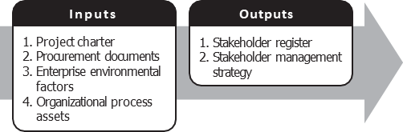
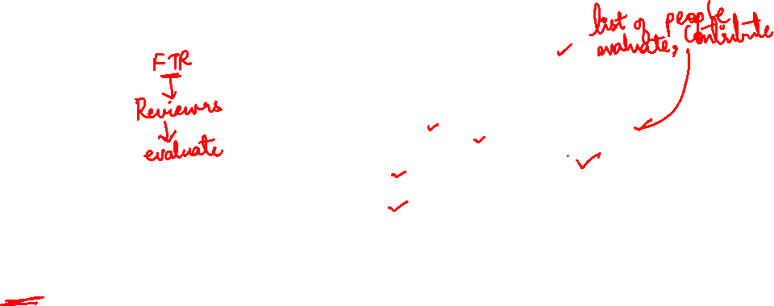
Identify Stakeholders
Identify Stakeholders is the process of identifying all people or organizations impacted by the project, and documenting relevant information regarding their interests, involvement, and impact on project success.

Slide 18

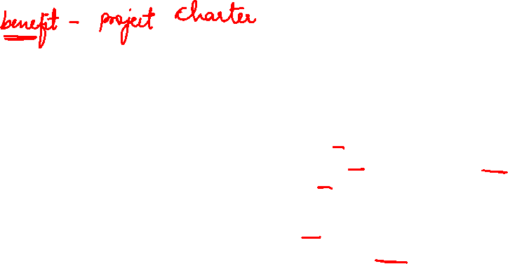
The key benefit of this process is a well-defined project start and project boundaries, creation of a formal record of the project, and a direct way for senior management to formally accept and commit to the project.
This document is a part of the project management process, which is required by Customer Relationship Management (CRM).

Slide 19
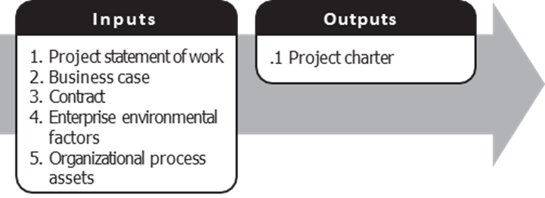
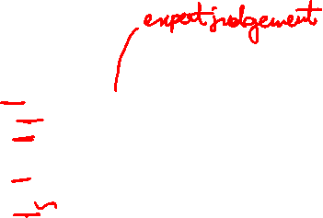
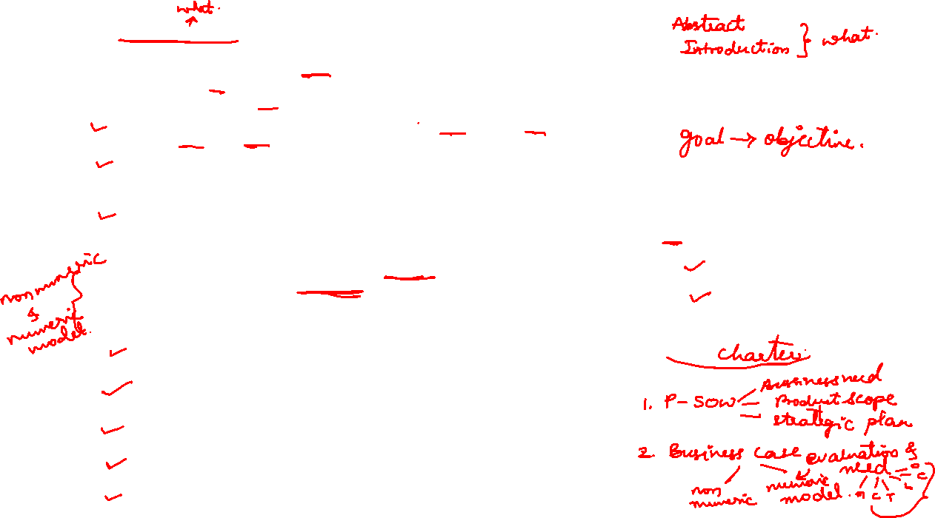
The statement of work (SOW) is a narrative description of products or services to be delivered by the project.
For internal projects, the project initiator or sponsor provides the statement of work based on business needs, product, or service requirements. For external projects, the statement of work can be received from the customer as part of a bid document, for example, request for proposal, request for information, request for bid, or as part of a contract. The SOW references:
Business need. An organization’s business need may be based on a market demand, technological advance, legal requirement, or government regulation.
Product scope description. This documents the characteristics of the product that the project will be undertaken to create. The description should also document the relationship between the products or services being created and the business need that the project will address.
Strategic plan. The strategic plan documents the organization’s strategic goals. Therefore, all projects should be aligned with the strategic plan.
Business Case
The business case or similar document provides the necessary information from a business standpoint to determine whether or not the project is worth the required investment. Typically the business need and the cost-benefit analysis are contained in the business case to justify the project. The requesting organization or customer, in the case of external projects, may write the business case. The business case is created as a result of one or more of the following:
Market demand (e.g., a car company authorizing a project to build more fuel-efficient cars in response to gasoline shortages),
Organizational need (e.g., a training company authorizing a project to create a new course to increase its revenues),
Customer request (e.g., an electric utility authorizing a project to build a new substation to serve a new industrial park),
Technological advance (e.g., an electronics firm authorizing a new project to develop a faster, cheaper, and smaller laptop after advances in computer memory and electronics technology),
Legal requirement (e.g., a paint manufacturer authorizing a project to establish guidelines for handling toxic materials),

Slide 20
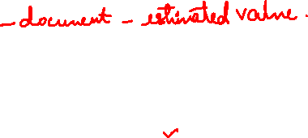
Contract
A contract is an input if the project is being done for an external customer.
Enterprise Environmental Factors
The enterprise environmental factors that can influence the Develop Project Charter process include, but are not limited to:
Governmental or industry standards,
Organization infrastructure, and
Marketplace conditions.
Organizational Process Assets
The organizational process assets that can influence the Develop Project Charter process include, but are not limited to:
Organizational standard processes, policies, and standardized process definitions for use in the organization;
Templates (e.g., project charter template); and
Historical information and lessons learned knowledge base.

Slide 21
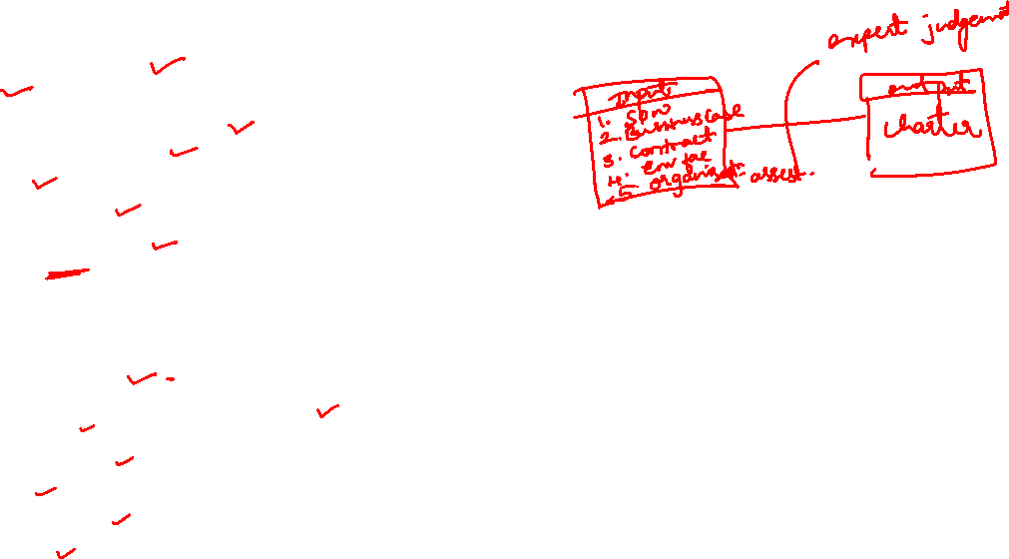
Expert Judgment
Expert judgment is often used to assess the inputs used to develop the project charter. Such judgment and expertise is applied to any technical and management details during this process. Such expertise is provided by any group or individual with specialized knowledge or training, and is available from many sources, including:
Other units within the organization,
Consultants,
Stakeholders, including customers or sponsors,
Professional and technical associations,
Industry groups,
Subject matter experts, and
Project management office (PMO).
Develop Project Charter: Outputs
Project Charter
The project charter documents the business needs, current understanding of the customer’s needs, and the new product, service, or result that it is intended to satisfy, such as:
Project purpose or justification,
Measurable project objectives and related success criteria,
High-level requirements,
High-level project description,
High-level risks,
Summary milestone schedule,
Summary budget,

Slide 22
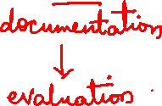
Project Proposal
it is appropriate to consider what documentation is needed to evaluate a project that is being considered. The set of documents submitted for evaluation is called the project proposal, whether it is brief (a page or two) or extensive, and regardless of the formality with which it is presented

Slide 23

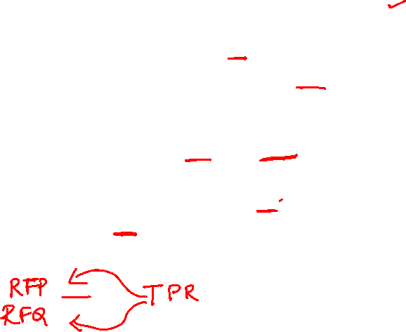
Problems in preparing proposal
These are:
1. Which projects should be bid on?
2. How should the proposal-preparation process be organized and staffed?
3. How much should be spent on preparing proposals for bids?
4. How should the bid prices be set? What is the bidding strategy? Is it ethical?
Request for Proposal (RFP) or Request for Quotation (RFQ)—more specifically, in the Technical Proposal Requirements (TPR) that is part of the RFP or RFQ

Slide 24
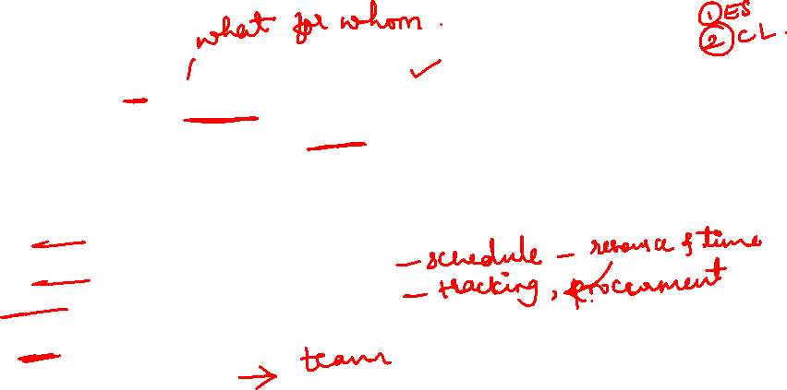
Contents in proposal
All proposals should begin with a short summary statement (an “Executive Summary”) covering the fundamental nature of the proposal in minimally technical language, as well as the general benefits that are expected. All proposals should be accompanied by a “cover letter.”
The cover letter is a key marketing document and is worthy of careful attention. In addition to the Executive Summary and the cover letter,every proposal should deal with four distinct issues:
(1) the nature of the technical problem and how it is to be approached;
(2) the plan for implementing the project once it has been accepted;
(3) the plan for logistic support and administration of the project; and
(4) a description of the group proposing to do the work, plus its past experience in similar work

Slide 25


Project Proposal Contents
Executive Summary
Cover Letter
Nature of the technical problem
Plan for Implementation of Project
Plan for Logistic Support & Administration of the project
Description of group proposing to do the work
Any relevant past experience that can be applied

Slide 26



Slide 27
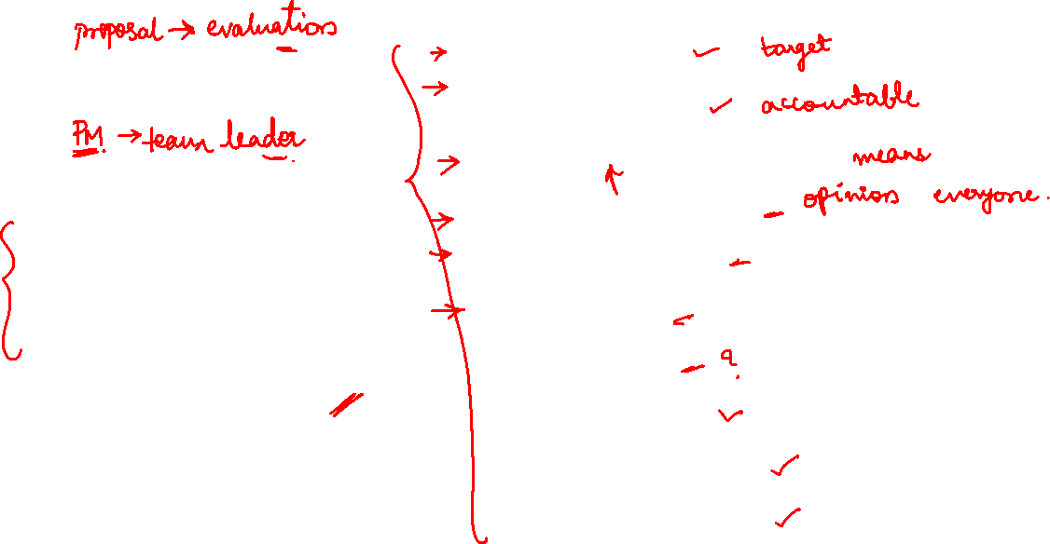
Effective team management
Clearly defined goals
• Clearly defined roles
• Open and clear communication
• Effective decision making
• Balanced participation
• Valued diversity
• Managed conflict
• Positive atmosphere
• Cooperative relationships
• Participative leadership

Slide 28
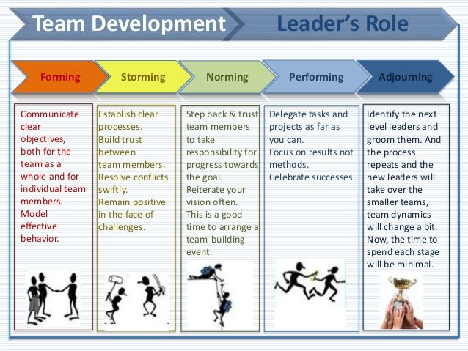

Team-Building Activities
• Forming
• Storming
• Norming
• Performing
• Adjourning

Slide 29
